Slide 1

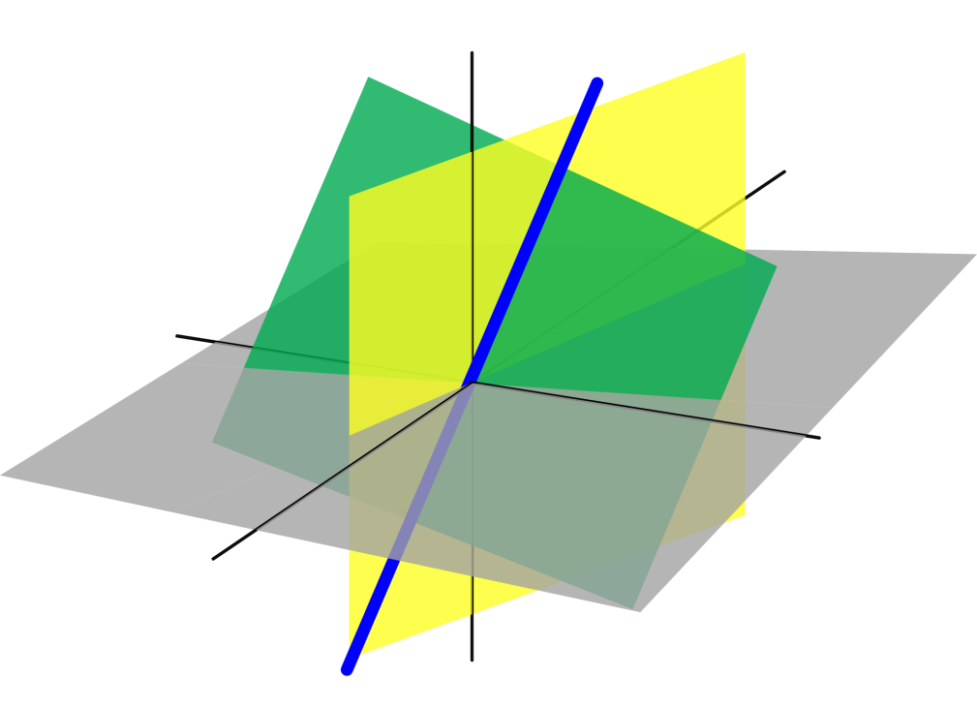
Azərbaycan Dövlət Neft və Sənaye Universiteti
Linear Algebra

Slide 2
In this lecture you will learn several important properties of determinants.
We begin by considering the determinant of the product of two matrices.
Properties of Determinants

Slide 3
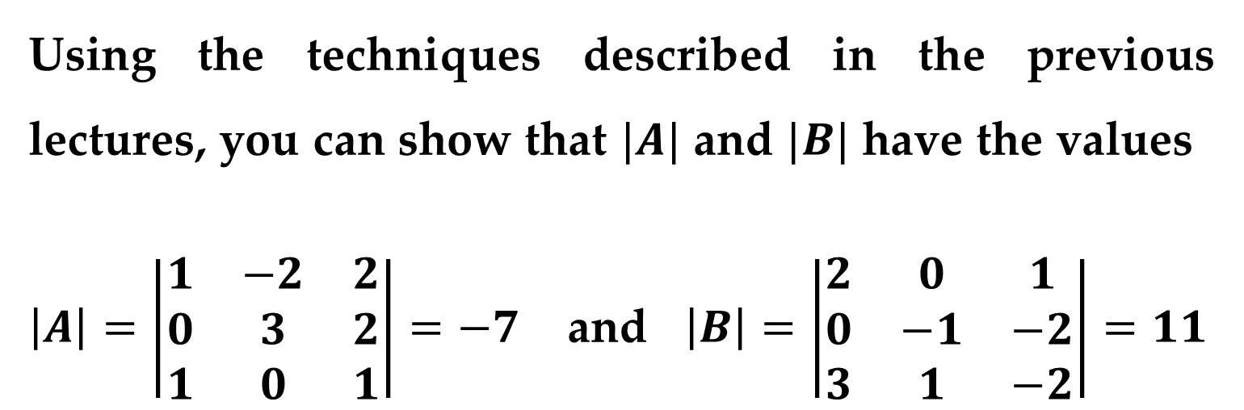
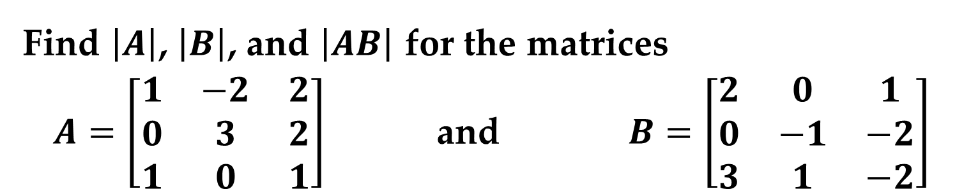
Example 1. The Determinant of a Matrix Product
Find $\left|A\right|$, $\left|B\right|$, and $\left|AB\right|$ for the matrices
$A=\left[\begin{matrix}1 & −2 & 2 \\ 0 & 3 & 2 \\ 1 & 0 & 1\end{matrix}\right]$ and $B=\left[\begin{matrix}2 & 0 & 1 \\ 0 & −1 & −2 \\ 3 & 1 & −2\end{matrix}\right]$
Solution
Using the techniques described in the previous lectures, you can show that $|A|$ and $|B|$ have the values
$\left|A\right|=\left|\begin{matrix}1 & −2 & 2 \\ 0 & 3 & 2 \\ 1 & 0 & 1\end{matrix}\right|=−7$ and $\left|B\right|=\left|\begin{matrix}2 & 0 & 1 \\ 0 & −1 & −2 \\ 3 & 1 & −2\end{matrix}\right|=11$
Properties of Determinants

Slide 4
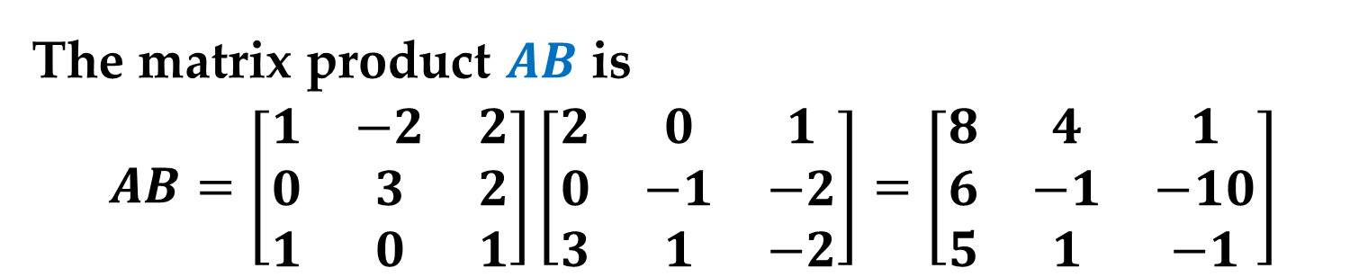
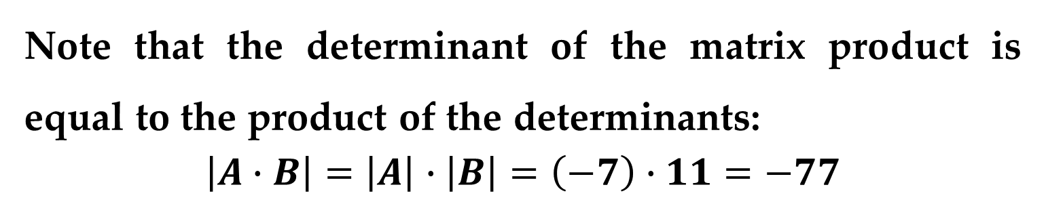
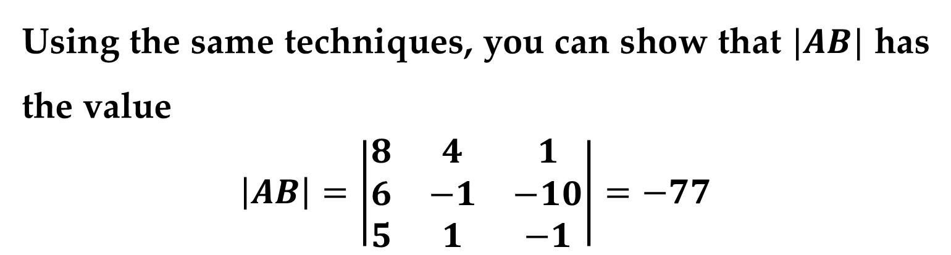
Solution (continued)
The matrix product $AB$ is
$$AB=\left[\begin{matrix}1 & −2 & 2 \\ 0 & 3 & 2 \\ 1 & 0 & 1\end{matrix}\right]\left[\begin{matrix}2 & 0 & 1 \\ 0 & −1 & −2 \\ 3 & 1 & −2\end{matrix}\right]=\left[\begin{matrix}8 & 4 & 1 \\ 6 & −1 & −10 \\ 5 & 1 & −1\end{matrix}\right]$$
Using the same techniques, you can show that $|AB|$ has the value
$$\left|AB\right|=\left|\begin{matrix}8 & 4 & 1 \\ 6 & −1 & −10 \\ 5 & 1 & −1\end{matrix}\right|=−77$$
Note that the determinant of the matrix product is equal to the product of the determinants:
$$\left|A∙B\right|=\left|A\right|∙\left|B\right|=\left(−7\right)∙11=−77$$

Slide 5

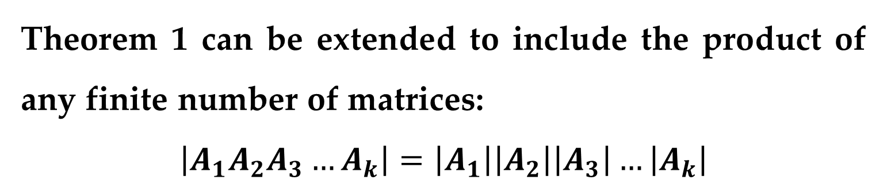
Theorem 1. Determinant of a Matrix Product
If $A$ and $B$ are square matrices of order $n$ then
$$\det\left(A∙B\right)=\det\left(A\right)∙det(B)$$
Remark
Theorem 1 can be extended to include the product of any finite number of matrices:
$$\left|A_{1}A_{2}A_{3}…A_{k}\right|=\left|A_{1}\right|\left|A_{2}\right|\left|A_{3}\right|…\left|A_{k}\right|$$
Properties of Determinants

Slide 6
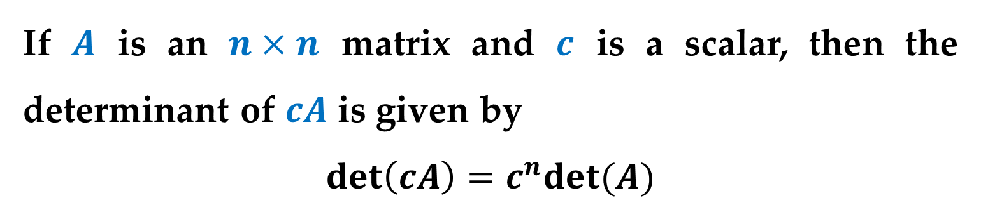

Theorem 2. Determinant of a Scalar Multiple of a Matrix
If $A$ is an $n×n$ matrix and $c$ is a scalar, then the determinant of $cA$ is given by
$$\det\left(cA\right)=c^{n}det(A)$$
Example 2. The Determinant of a Scalar Multiple of a Matrix
Find the determinant of the matrix
$$A=\left[\begin{matrix}10 & −20 & 40 \\ 30 & 0 & 50 \\ −20 & −30 & 10\end{matrix}\right]$$
Properties of Determinants

Slide 7
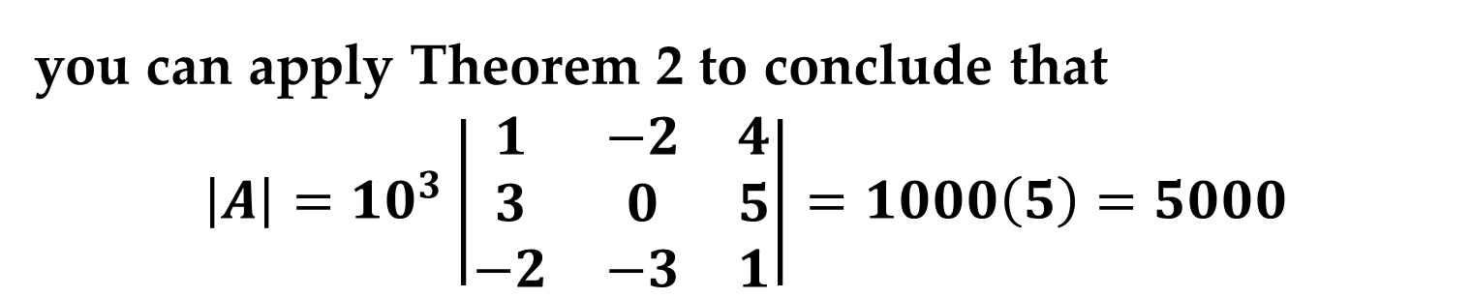
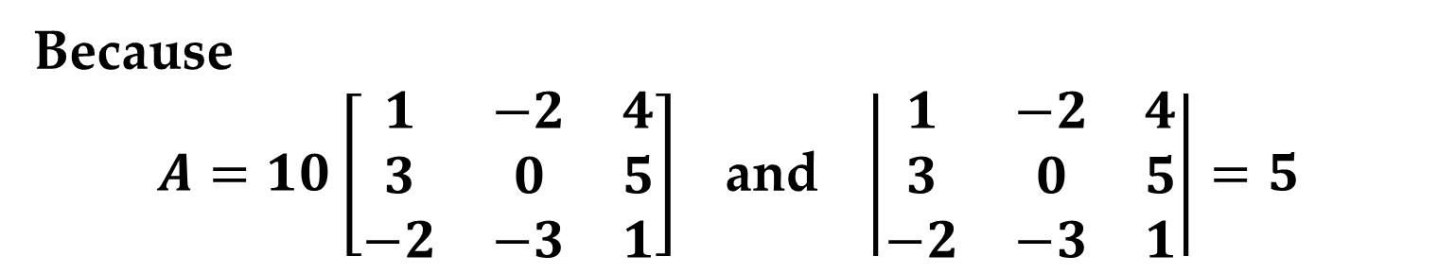
Solution
Because
$A=10\left[\begin{matrix}1 & −2 & 4 \\ 3 & 0 & 5 \\ −2 & −3 & 1\end{matrix}\right]$ and $\left|\begin{matrix}1 & −2 & 4 \\ 3 & 0 & 5 \\ −2 & −3 & 1\end{matrix}\right|=5$
you can apply Theorem 2 to conclude that
$$\left|A\right|=10^{3}\left|\begin{matrix}1 & −2 & 4 \\ 3 & 0 & 5 \\ −2 & −3 & 1\end{matrix}\right|=1000\left(5\right)=5000$$
Properties of Determinants

Slide 8
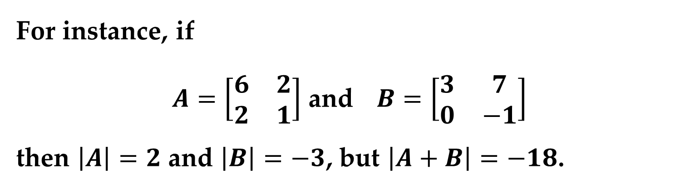
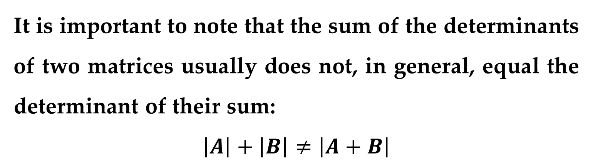
Remark
It is important to note that the sum of the determinants of two matrices usually does not, in general, equal the determinant of their sum:
$$\left|A\right|+\left|B\right|≠\left|A+B\right|$$
For instance, if
$A=\left[\begin{matrix}6 & 2 \\ 2 & 1\end{matrix}\right]$ and $B=\left[\begin{matrix}3 & 7 \\ 0 & −1\end{matrix}\right]$
then $\left|A\right|=2$ and $\left|B\right|=−3$, but $\left|A+B\right|=−18$.
Properties of Determinants

Slide 9
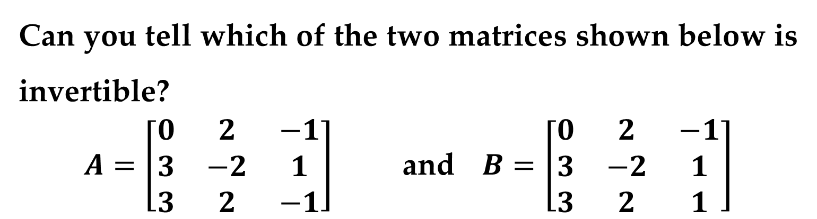
Some square matrices are not invertible. It can also be difficult to tell simply by inspection whether or not a matrix has an inverse.
Can you tell which of the two matrices shown below is invertible?
$A=\left[\begin{matrix}0 & 2 & −1 \\ 3 & −2 & 1 \\ 3 & 2 & −1\end{matrix}\right]$ and $B=\left[\begin{matrix}0 & 2 & −1 \\ 3 & −2 & 1 \\ 3 & 2 & 1\end{matrix}\right]$
The next theorem shows that determinants are useful for classifying square matrices as either invertible or noninvertible.

Slide 10
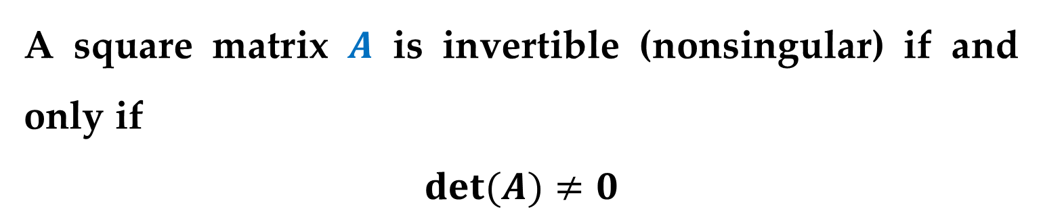
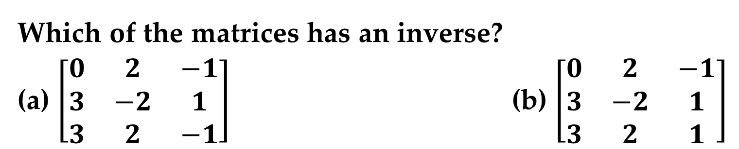
Theorem 3. Determinant of an Invertible Matrix
A square matrix $A$ is invertible (nonsingular) if and only if
$$det(A)≠0$$
Example 3. Classifying Square Matrices as Singular or Nonsingular
Which of the matrices has an inverse?
(a) $\left[\begin{matrix}0 & 2 & −1 \\ 3 & −2 & 1 \\ 3 & 2 & −1\end{matrix}\right]$ (b) $\left[\begin{matrix}0 & 2 & −1 \\ 3 & −2 & 1 \\ 3 & 2 & 1\end{matrix}\right]$
Determinants and the Inverse of a Matrix

Slide 11


Solution
Because
$$\left|\begin{matrix}0 & 2 & −1 \\ 3 & −2 & 1 \\ 3 & 2 & −1\end{matrix}\right|=0$$
you can conclude that this matrix has no inverse (it is singular).
(b) Because
$$\left|\begin{matrix}0 & 2 & −1 \\ 3 & −2 & 1 \\ 3 & 2 & 1\end{matrix}\right|=−12≠0$$
you can conclude that this matrix has an inverse (it is non-singular).

Slide 12

The next theorem provides a convenient way to find the determinant of the inverse of a matrix.
Theorem 4. Determinant of an Inverse Matrix
If $A$ is invertible, then
$$\det\left(A^{−1}\right)=\frac{1}{det(A)}$$
Determinants and the Inverse of a Matrix

Slide 13
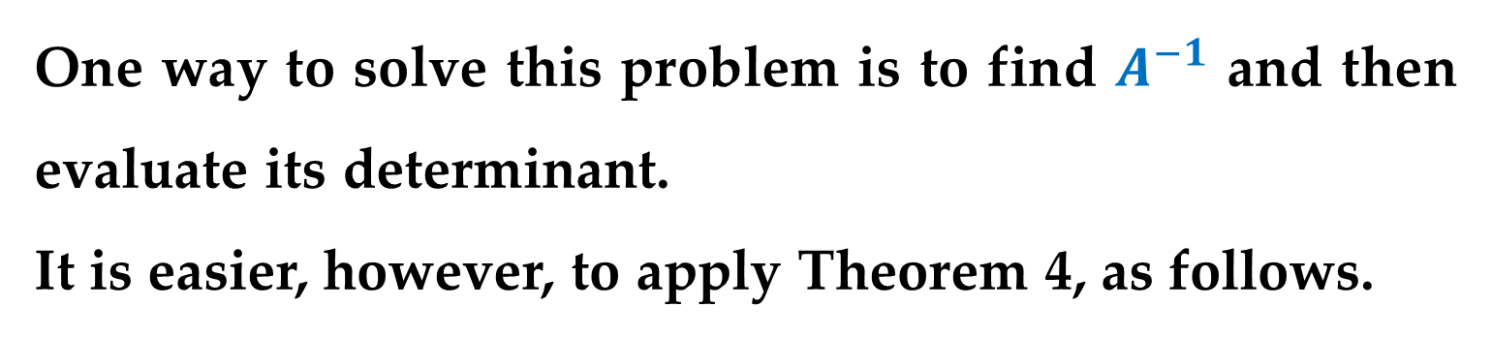

Example 4. The Determinant of the Inverse of a Matrix
Find $\left|A^{−1}\right|$ for the matrix
$$A=\left[\begin{matrix}1 & 0 & 3 \\ 0 & −1 & 2 \\ 2 & 1 & 0\end{matrix}\right]$$
Solution
One way to solve this problem is to find $A^{−1}$ and then evaluate its determinant.
It is easier, however, to apply Theorem 4, as follows.
Determinants and the Inverse of a Matrix

Slide 14
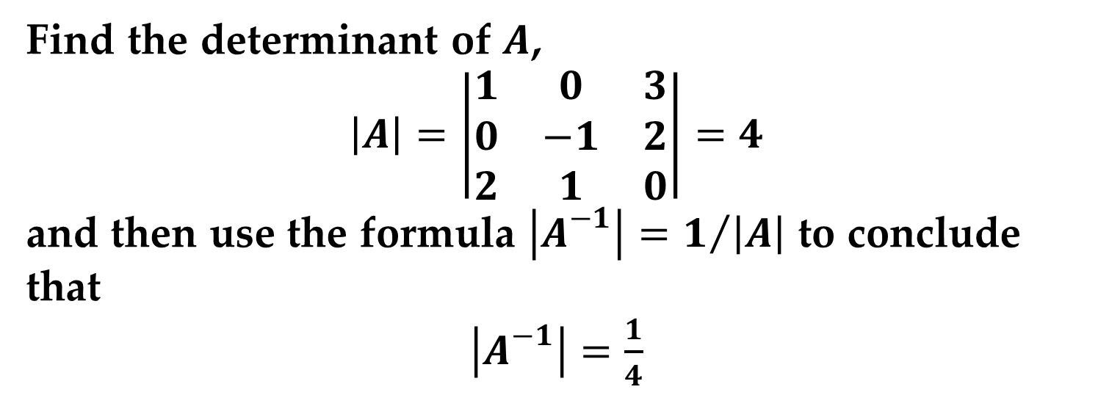
Determinants and the Inverse of a Matrix
Solution (continued)
Find the determinant of $A$,
$$\left|A\right|=\left|\begin{matrix}1 & 0 & 3 \\ 0 & −1 & 2 \\ 2 & 1 & 0\end{matrix}\right|=4$$
and then use the formula $\left|A^{−1}\right|=1/{\left|A\right|}$ to conclude that
$\left|A^{−1}\right|=\frac{1}{4}$

Slide 15
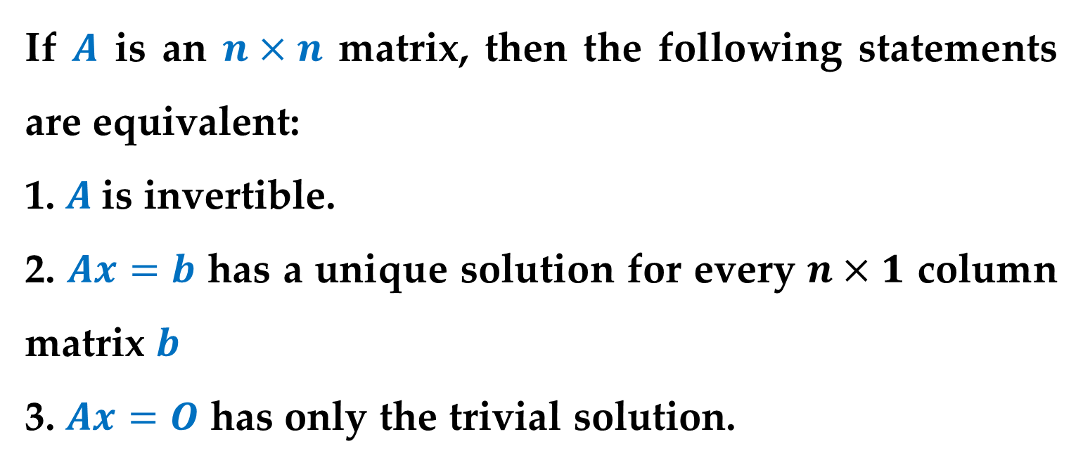
Definition (Equivalent Conditions for a Nonsingular Matrix)
If $A$ is an $n×n$ matrix, then the following statements are equivalent:
1. $A$is invertible.
2. $Ax=b$ has a unique solution for every $n×1$ column matrix $b$
3. $Ax=O$ has only the trivial solution.
Determinants and the Inverse of a Matrix

Slide 16
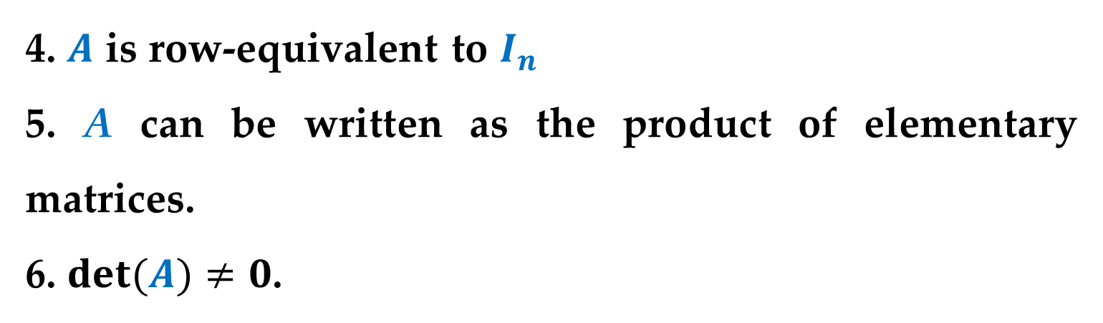
Definition (Equivalent Conditions for a Nonsingular Matrix)
4. $A$ is row-equivalent to $I_{n}$
5. A can be written as the product of elementary matrices.
6. $det(A)≠0$.
Determinants and the Inverse of a Matrix

Slide 17
Remark
In our previous lectures you saw that a square matrix can have a determinant of zero if it is row-equivalent to a matrix that has at least one row (or column) consisting entirely of zeros.
The validity of this statement follows from the equivalence of Properties 4 and 6.
Determinants and the Inverse of a Matrix

Slide 18
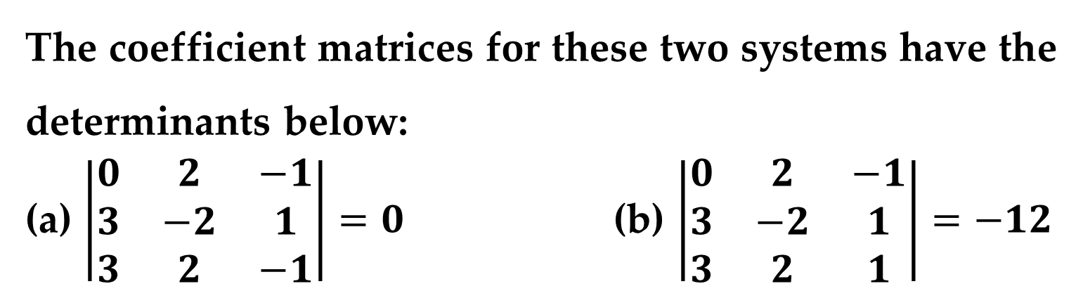
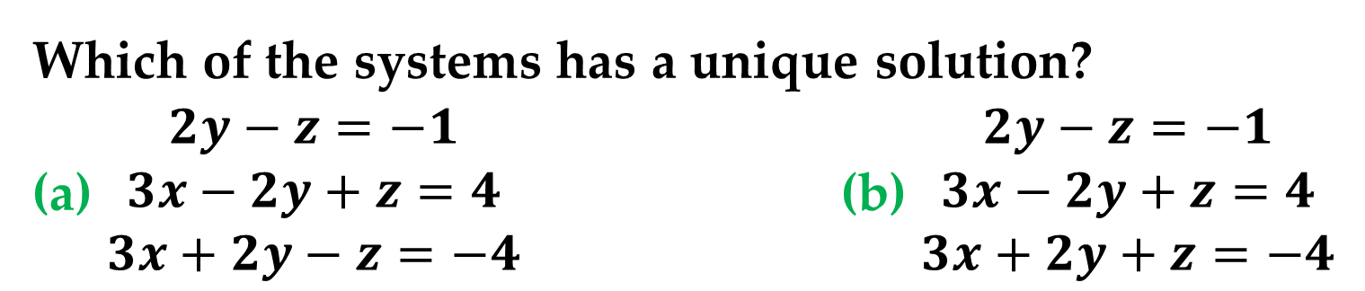
Example 5. Systems of Linear Equations
Which of the systems has a unique solution?
(a) $\begin{matrix}2y−z=−1 \\ 3x−2y+z=4 \\ 3x+2y−z=−4\end{matrix}$ (b) $\begin{matrix}2y−z=−1 \\ 3x−2y+z=4 \\ 3x+2y+z=−4\end{matrix}$
Solution
The coefficient matrices for these two systems have the determinants below:
(a) $\left|\begin{matrix}0 & 2 & −1 \\ 3 & −2 & 1 \\ 3 & 2 & −1\end{matrix}\right|=0$ (b) $\left|\begin{matrix}0 & 2 & −1 \\ 3 & −2 & 1 \\ 3 & 2 & 1\end{matrix}\right|=−12$
Using the preceding list of equivalent conditions, you can conclude that only the second system has a unique solution.

Slide 19

The next theorem tells you that the determinant of the transpose of a square matrix is equal to the determinant of the original matrix.
Theorem 5. Determinant of a Transpose
If $A$ is a square matrix, then
$$\det\left(A\right)=det(A^{T})$$
Determinants and the Transpose of a Matrix

Slide 20
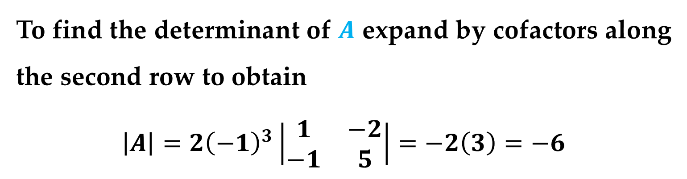

Example 6. The Determinant of a Transpose
Show that $\left|A\right|=\left|A^{T}\right|$ for the matrix below
$$A=\left[\begin{matrix}3 & 1 & −2 \\ 2 & 0 & 0 \\ −4 & −1 & 5\end{matrix}\right]$$
Solution
To find the determinant of $A$ expand by cofactors along the second row to obtain
$$\left|A\right|=2{\left(−1\right)}^{3}\left|\begin{matrix}1 & −2 \\ −1 & 5\end{matrix}\right|=−2\left(3\right)=−6$$
Determinants and the Transpose of a Matrix

Slide 21
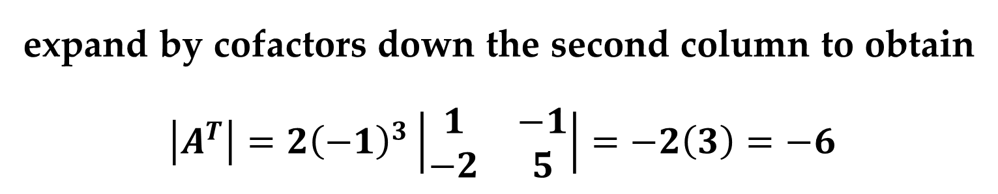

Solution (continued)
To find the determinant of
$$A^{T}=\left[\begin{matrix}3 & 2 & −4 \\ 1 & 0 & −1 \\ −2 & 0 & 5\end{matrix}\right]$$
expand by cofactors down the second column to obtain
$$\left|A^{T}\right|=2{\left(−1\right)}^{3}\left|\begin{matrix}1 & −1 \\ −2 & 5\end{matrix}\right|=−2\left(3\right)=−6$$
Thus, $\left|A\right|=|A^{T}|$.
Determinants and the Transpose of a Matrix

Slide 22
Thank You for Attention

